Slide 1

K-Nearest Neighbor (KNN) Classification
By:
Dr. G G Md Nawaz Ali
E-mail: nali@fsmail.bradley.edu
Slide courtesy:
Dr. Babu K. Baniya
Pierian Data
Ref:
Python Machine Learning by Wei-Meng Lee
An Introduction to Statistical learning by Gareth James

Slide 2
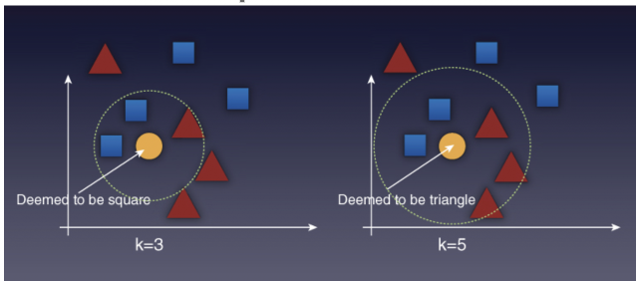
KNN Working Principle
KNN works on a very simple principle
KNN works by comparing the query instance's distance to the other training samples and selecting the K‐nearest neighbors
It then takes the majority of these K‐neighbor classes to be the prediction of the query instance.
The classification of a point depends on the majority of its neighbors
Ref: Python Machine Learning by Wei-Meng Lee

Slide 3
K-Nearest Neighbor
Features
All instances correspond to points in an n-dimensional Euclidean space
Classification is delayed till a new instance arrives
Classification done by comparing feature vectors of the different points
Target function may be discrete (classification) or real-valued (regression)

Slide 4
1-Nearest Neighbor

Slide 5
K-Nearest Neighbor
K-nearest neighbors of a record x are data points that have the k smallest distance to x

Slide 6
KNN Algorithm
Training Algorithm:
Store all the data
Prediction Algorithm:
Calculate the distance from x to all points in your data
Sort the points in your data by increasing distance from x
Predict the majority label of the “k” closest points

Slide 7
K-Nearest Neighbor
An arbitrary instance is represented by: (a₁(x), a₂(x), a₃(x),.., a_{n}(x))
a_{i}(x) denotes features
Euclidean distance between two instances
d(x_{i}, x_{j})=sqrt (sum for r=1 to n (a_{r}(x_{i}) - a_{r}(x_{j}))²)
Continuous valued target function
mean value of the k nearest training examples

Slide 8

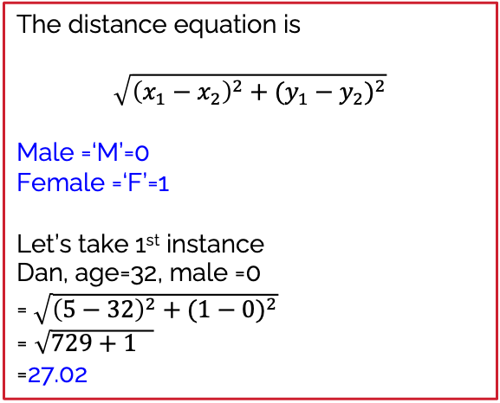


Example of K-NN
Name | Age | Gender | Class (game)
Dan | 32 | M | Baseball
Mark | 40 | M | Neither
Nancy | 16 | F | Tennis
Sally | 14 | F | Tennis
Ram | 55 | M | Neither
Rahul | 40 | M | Tennis
Pooja | 20 | F | Neither
Smith | 15 | M | Tennis
Laxmi | 55 | F | Baseball
Mike | 15 | M | Baseball
The distance equation is
$$\sqrt{{\left(x_{1}−x_{2}\right)}^{2}+{(y_{1}−y_{2})}^{2}}$$
Male =‘M’=0
Female =‘F’=1
Let’s take 1st instance
Dan, age=32, male =0
=$\sqrt{{\left(5−32\right)}^{2}+{(1−0)}^{2}}$
= $\sqrt{729+1 }$
=27.02
Tera | 5 | F | ? (if k=3)

Slide 9
Example of K-NN (with Distance)
Name | Age | Gender | Distance (with Tera) | Class (game)
Dan | 32 | 0 | 27.02 | Baseball
Mark | 40 | 0 | 35.01 | Neither
Nancy | 16 | 1 | 11.00 | Tennis
Sally | 14 | 1 | 9.00 | Tennis
Ram | 55 | 0 | 50.01 | Neither
Rahul | 40 | 0 | 35.01 | Tennis
Pooja | 20 | 1 | 15.00 | Neither
Smith | 15 | 0 | 10.00 | Tennis
Laxmi | 55 | 1 | 50.00 | Baseball
Mike | 15 | 0 | 10.05 | Baseball
Result (distance from Tera):
K=3
Sally =9 belongs to Tennis
Smith =10.00 belongs to Tennis
Mike =10.05 belongs to Baseball
Hence Tera belongs to
Tennis game group
Birds of a feather flock together

Slide 10
Choosing the right value for K
Choosing the value of k:
If k is too small, sensitive to noise points
If k is too large, neighborhood may include points from other classes
Rule of thumb:
K = sqrt(N)
N: number of training points

Slide 11
Pros and Cons of KNN
Pros
Simple to understand
Training is trivial
Works with any number of classes
Not many parameters:
K
Distance metric
Cons
High prediction cost for large data set
Does not work well with high dimensional data
Categorical features does not work well

Slide 12
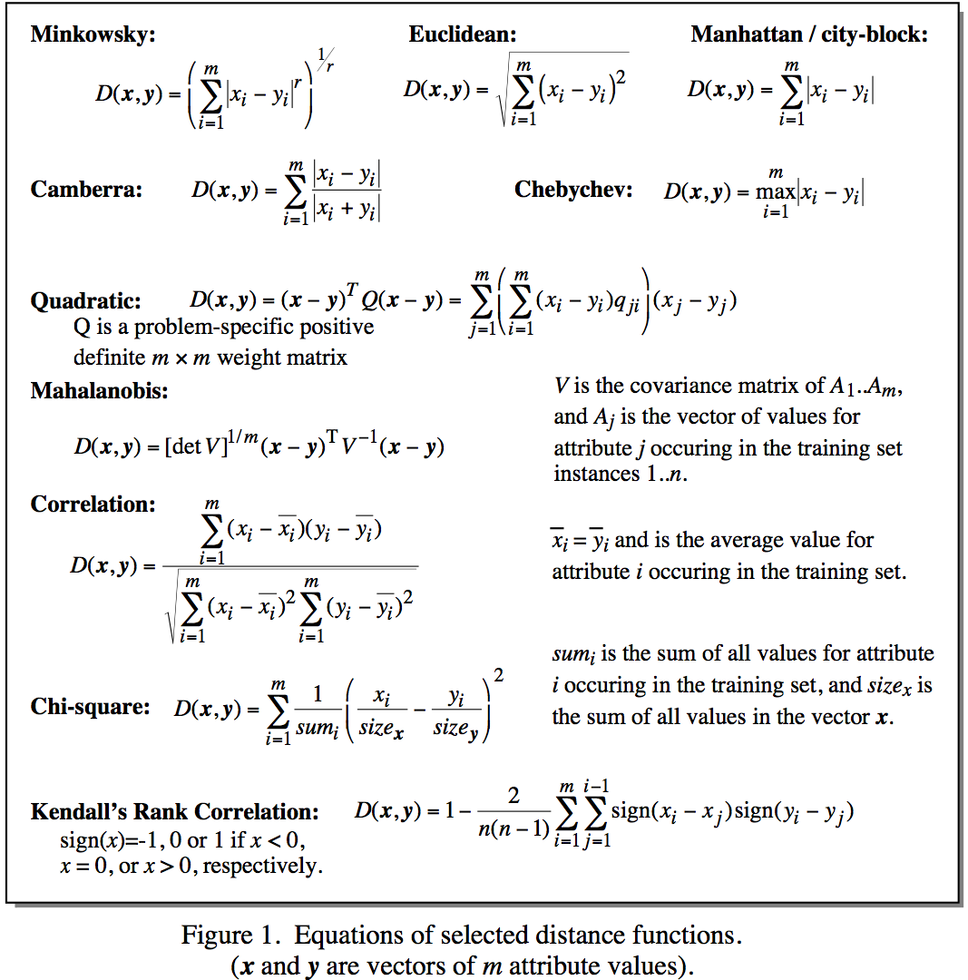
Distance Matrix

Slide 13
Underfitting (high bias) and Overfitting (high variance)
References:
https://illustrated-machine-learning.github.io/
https://medium.com/@francesco.disalvo/the-bias-variance-tradeoff-an-illustrated-guide-6c79214b0c2b

Slide 14
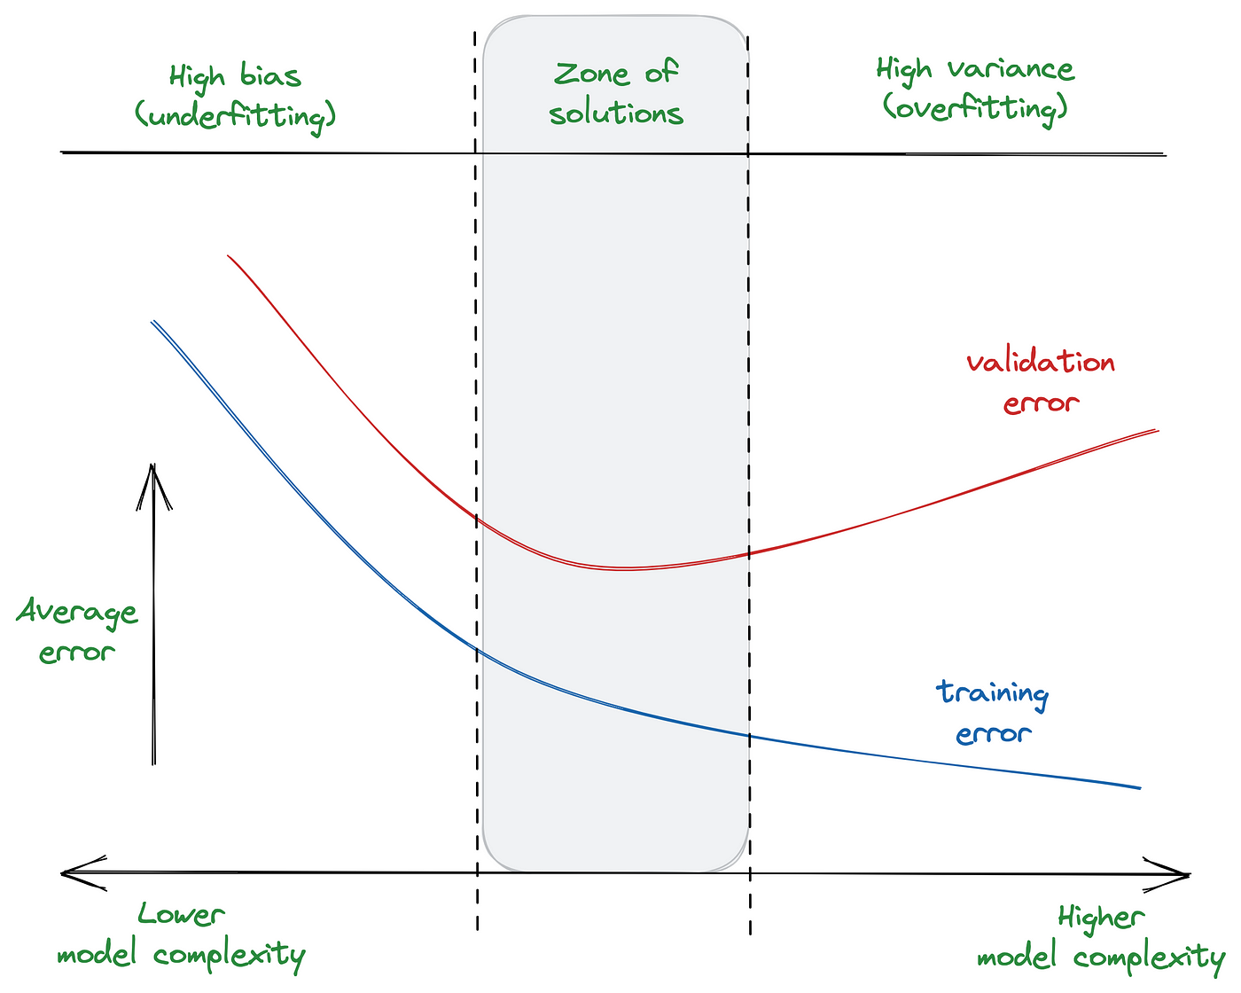
Bias vs. variance
The variance reflects the variability of the predictions whereas the bias is the difference between the forecast and the true values (error).
Ideally, we hope to reach a low bias (error) and a low variance
However, this rarely happens, and this is why we need to rely on this “trade-off”.
The overall goal is to reach the so-called zone of solution, an optimal zone that balances these two holy metrics.
Refs:
https://illustrated-machine-learning.github.io/
https://medium.com/@francesco.disalvo/the-bias-variance-tradeoff-an-illustrated-guide-6c79214b0c2b

Slide 15
Underfitting
Underfitting
Model does not capture the underlying trend of the data and does not fit the data well enough.
Low variance but high bias.
Underfitting is often a result of an excessively simple model.
Ref: pierian data

Slide 16
Underfitting
Data
Y
X
Ref: pierian data

Slide 17
Underfitting
The most common causes are:
The model is too simple for the data
The features are not informative enough
You regularize too much (hence, the model becomes too simple)
Y
Possible solutions are:
Try with more complex models
Select those features with a higher predictive power
Add more training data (if possible)
Reduce regularization
X
Refs:
https://illustrated-machine-learning.github.io/
https://medium.com/@francesco.disalvo/the-bias-variance-tradeoff-an-illustrated-guide-6c79214b0c2b

Slide 18
Overfitting
The model fits too much to the noise from the data.
This often results in low error on training sets but high error on test/validation sets.
Ref: pierian data

Slide 19
Overfitting (cont.)
Data
Y
X
Ref: pierian data

Slide 20
Overfitting (cont.)
Good Model
Y
The model is able to show the trend/pattern of the data
X
Ref: pierian data

Slide 21
Overfitting (cont.)
Overfitting
Y
X
Ref: pierian data

Slide 22
Overfitting (cont.)
Overfitting
Some of the most common causes of overfitting issues are:
The model is too complex and it is not able to generalize enough on unseen data
There are too many features
There is not enough regularization (which may help to reduce the model complexity)
Y
X
Refs:
https://illustrated-machine-learning.github.io/
https://medium.com/@francesco.disalvo/the-bias-variance-tradeoff-an-illustrated-guide-6c79214b0c2b

Slide 23
Overfitting (cont.)
Solving overfitting issues:
Try to use simpler models
Try to reduce the degree of the regression (if applicable)
Try linear kernels (if applicable, e.g., SVM)
Try reducing layers/units (if applicable, e.g., ANN)
Y
“Degree of a regression line”:
Refers to the steepness of the line
It is primarily measured by the slope of the regression line
A steeper slope indicates a higher degree of change, meaning a stronger relationship between the variables
X
Refs:
https://illustrated-machine-learning.github.io/
https://medium.com/@francesco.disalvo/the-bias-variance-tradeoff-an-illustrated-guide-6c79214b0c2b

Slide 24
Overfitting (cont.)
Y
high variance in training
X
yields larger error in testing
Ref: pierian data

Slide 25
Overfitting (cont.)
This data was easy to visualize, but how can we see underfitting and overfitting when dealing with multi dimensional data sets?
First let’s imagine we trained a model and then measured its error over training time.
Ref: pierian data

Slide 26
Overfitting (cont.)
Good Model
Error
Training Time
solution is in here
Ref: pierian data

Slide 27
Overfitting (cont.)
Bad Model
Error
Overshooting happened from this point
Epochs/iterations
Ref: pierian data

Slide 28
In summary
When thinking about overfitting and underfitting we want to keep in mind the relationship of model performance on the training set versus the test/validation set.

